Slide 1

The C PROGRAMMING LANGUAGE
Notes:
NOTE: Want a different image on this slide? Select the picture and delete it. Now click the Pictures icon in the placeholder to insert your own image.

Slide 2
CONTENTS
INTRODUCTION
DATATYPES USED
OPERATORS
BITWISE OPERATORS
OPERATOR PRECEDENCE
FUNCTIONS
POINTERS
SCOPE OF VARIABLES
STORAGE CLASSES
STRUCTURES & UNIONS
RECURSION
C PREPROCESSORS
DATASTRUCTURES

Slide 3
INTRODUCTION
Developed by Dennis Ritche in the Bell Labs
Is a structured , low level ,machine independent language.
Easy to learn
It produces efficient programs
A C program basically consists of the following parts −
Preprocessor Commands
Functions
Variables
Statements & Expressions
Comments

Slide 4
Let us look at a simple code that would print the words "Hello World" −
Live Dem
#include <stdio.h>
int main()
{
/* my first program in C */
printf("Hello, World! \n");
return 0;
}
The first line of the program #include <stdio.h> is a preprocessor command, which tells a C compiler to include stdio.h file before going to actual compilation.
The next line int main() is the main function where the program execution begins.
The next line /*...*/ will be ignored by the compiler and it has been put to add additional comments in the program. So such lines are called comments in the program.
The next line printf(...) is another function available in C which causes the message "Hello, World!" to be displayed on the screen.
The next line return 0; terminates the main() function and returns the value 0.

Slide 5
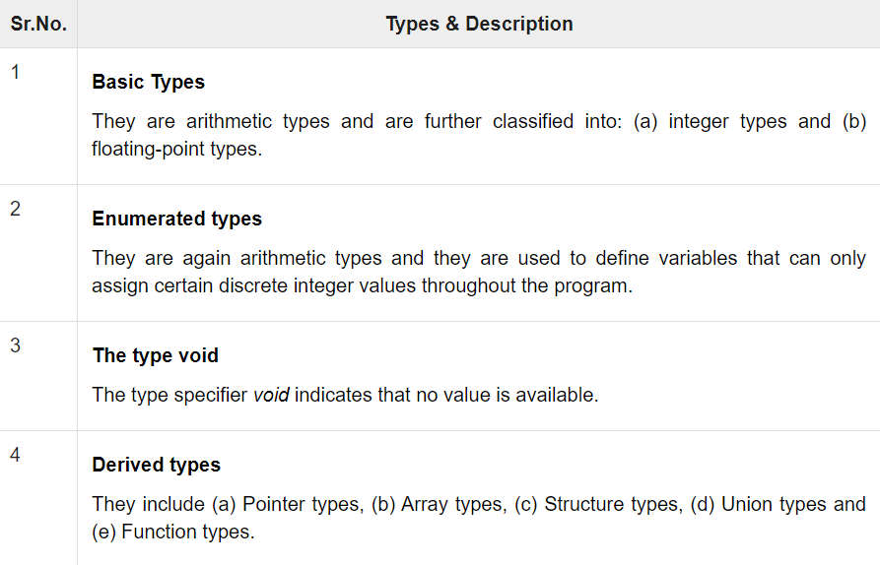
DATATYPES USED
Data types in c refer to an extensive system used for declaring variables or functions of different types. The type of a variable determines how much space it occupies in storage and how the bit pattern stored is interpreted.

Slide 6
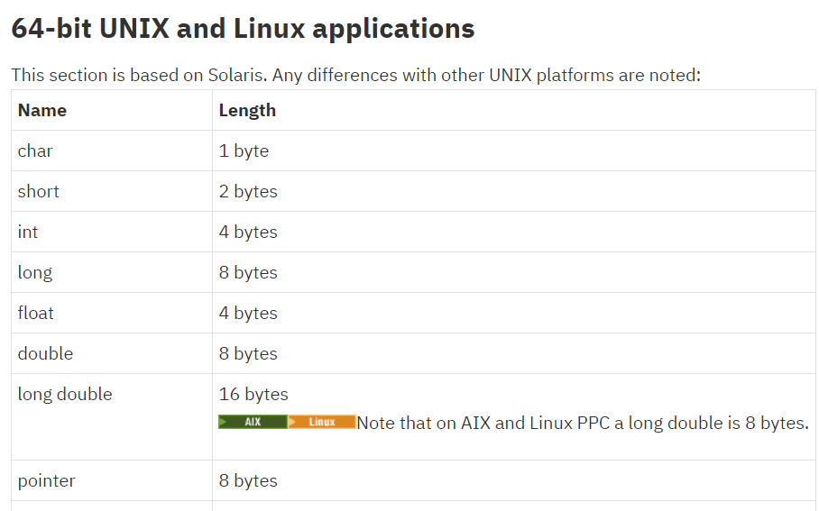
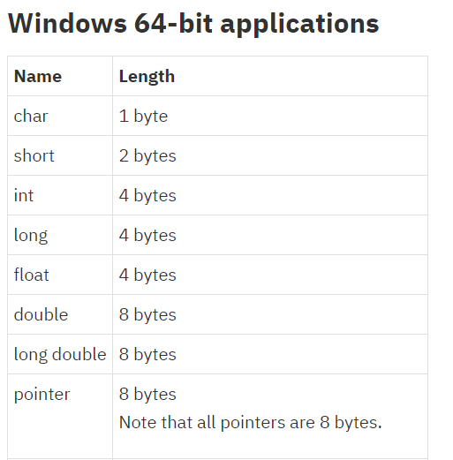
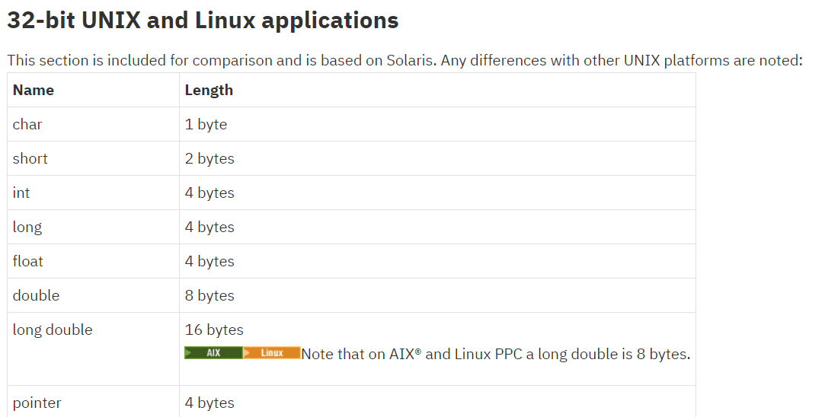

Slide 7
OPERATORS IN C
C language supports a rich set of built-in operators. An operator is a symbol that tells the compiler to perform a certain mathematical or logical manipulation. Operators are used in programs to manipulate data and variables.
C operators can be classified into following types:
Arithmetic operators:- (+,-,*,/,++.--,%)
Relational operators:- (==,!=,>,<,>=,<=)
Logical operators:- (&&(Logical AND operator),||(Logical OR),!(Logical NOT))
Bitwise operators:- (&, |, and ^ )
Assignment operators:- (+=,-=)
Special operators:- (sizeof,*,?)

Slide 8
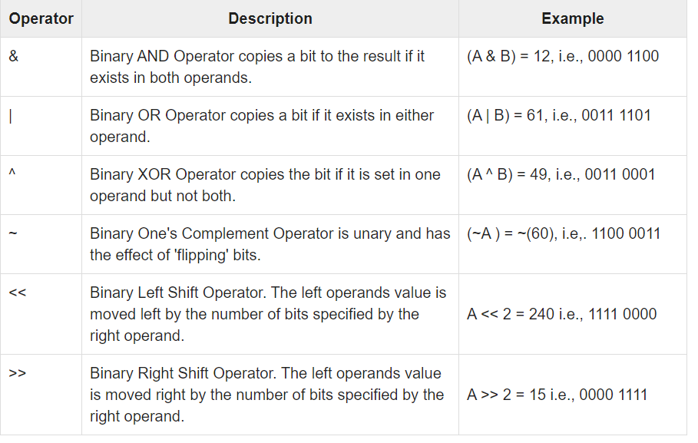
BITWISE OPERATORS
The following table lists the Bitwise operators supported by C. Assume variable 'A' holds 60 and variable 'B' holds 13, then −

Slide 9
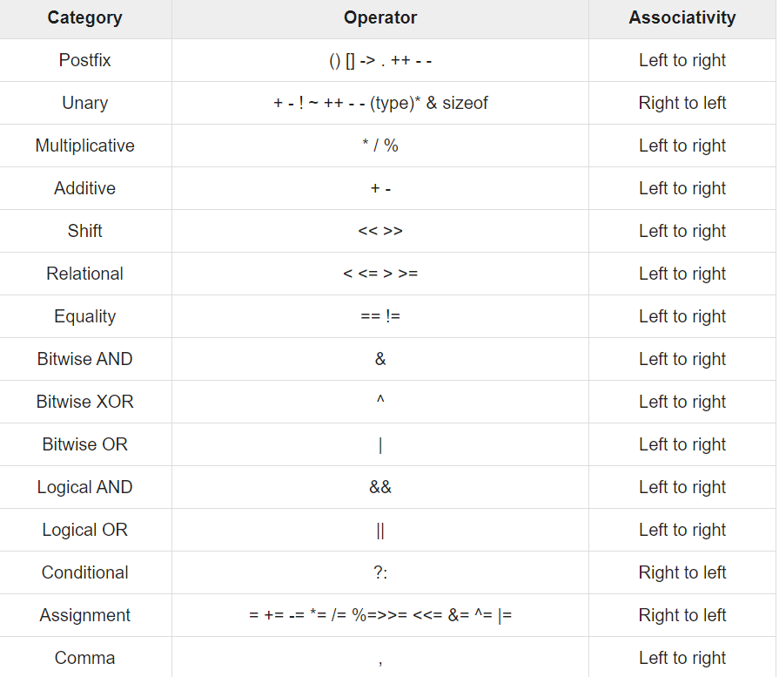
OPERATOR PRECEDENCE
Operator precedence determines the grouping of terms in an expression and decides how an expression is evaluated. Certain operators have higher precedence than others; for example, the multiplication operator has a higher precedence than the addition operator.
For example, x = 7 + 3 * 2; here, x is assigned 13, not 20 because operator * has a higher precedence than +, so it first gets multiplied with 3*2 and then adds into 7.
Here, in the table given operators with the highest precedence appear at the top of the table, those with the lowest appear at the bottom. Within an expression, higher precedence operators will be evaluated first.

Slide 10
Introduction to Functions
A complex problem is often easier to solve by dividing it into several smaller parts, each of which can be solved by itself.
This is called structured programming.
These parts are sometimes made into functions in C.
main() then uses these functions to solve the original problem.

Slide 11
ADVANTAGES:-
Functions separate the concept (what is done) from the implementation (how it is done).
C++ allows the use of both internal (user-defined) and external functions.
Functions make programs easier to understand.
Functions can be called several times in the same program, allowing the code to be reused.
C++ programs usually have the following form:
// include statements
// function prototypes
// main() function
// function definitions

Slide 12

Function Input and Output
FUNCTION DEFINATION:- A function definition has the following syntax: ​
<type> <function name>(<parameter list>){​
<local declarations> ​
<sequence of statements> ​
}​
For example: Definition of a function that computes the absolute value of an integer:​
​
int absolute(int x){ ​
if (x >= 0) return x; ​
else return -x;

Slide 13
FUNCTION CALL:- A function call has the following syntax:
<function name>(<argument list>)
Example: int distance = absolute(-5);
The result of a function call is a value of type <type>
FUNCTION PROTOTYPE:- The function prototype declares the input and output parameters of the function.
The function prototype has the following syntax:
<type> <function name>(<type list>);
Example: A function that returns the absolute value of an integer is: int absolute(int);
FUNCTION DEFINATION:- The function definition can be placed anywhere in the program after the function prototypes.
If a function definition is placed in front of main(), there is no need to include its function prototype

Slide 14
CALL BY VALUE VS CALL BY REFERENCE
.
CALL BY VALUE
CALL BY REFERENCE
While calling a function, we pass values of variables to it. Such functions are known as “Call By Values”.
While calling a function, instead of passing the values of variables, we pass address of variables(location of variables) to the function known as “Call By References.
In this method, the value of each variable in calling function is copied into corresponding dummy variables of the called function.
In this method, the address of actual variables in the calling function are copied into the dummy variables of the called function.

Slide 15
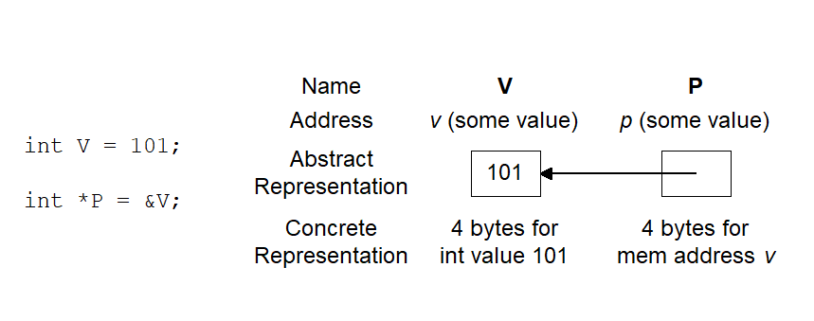
POINTERS:-
A pointer is a reference to another variable in a program.
Variables are allocated addresses in computer memory
Name of the variable is the reference to that memory address .
A pointer .contains the address of another variable

Slide 16
Basic Syntax: variable-type * name-of-the-variable;
Examples :
int *p ; /* p is a pointer that can point to int variable */
char *ar; /* ar is a pointer that can point to char variable */
float *f; /* f is a pointer that can point to float variable */
Complex Examples :
Int *ar[5] /*ar is an array of 5 pointers to int*/
ADDRESS OPERATOR:-The address operator can be used in any variable object in C
The output of the operation is that it returns the address of the variable .
Syntax : &variable-reference ;
Examples :
int v;
int *p;
&v – returns the memory location of the integer variable v
&p – memory location of the pointer variable p

Slide 17
INDIRECTION OPERATOR:- A pointer contains the memory address of a variable , to refer to the content of the pointer variable indirection operator is used .
Syntax : *pointer-variable ;
Examples :
int v =101;
int *p =&v ;
/*Then p would refer to the contents of the variable v */
REFERENCE POINTERS:- To make changes to a variable that exist after a function ends, we pass the address of (a pointer to) the variable to the function (a reference parameter) .Then we use indirection operator inside the function to change the value the parameter points to .
Example :
void changeVar(float *cvar) {
*cvar = *cvar + 10.0;
}
float X = 5.0;
changeVar(&X);
printf(“%.1f\n”,X);

Slide 18
POINTER TO POINTER:- A pointer can be made to point to another pointer (but the pointer must be of a type that allows it to point to a pointer )
Examples :
int V = 101;
int *P = &V; /* P points to int V */
int **Q = &P; /* Q points to int pointer P */
printf(“%d %d %d\n”,V,*P,**Q); /* prints 101 3 times */
Types of pointers:-
Type | Defination | Example
GENERIC POINTERS | Generic pointers are used when we want to return such pointer which is applicable to all types of pointers. For example return type of malloc function is generic pointer because it can dynamically allocate the memory space to stores integer, float, structure etc | void *ptr;

Slide 19
TYPE | DEFINATION | EXAMPLE
Dangling pointer | A pointer pointing to a memory location that has been deleted (or freed) is called dangling pointer. | int *ptr = (int *)malloc(sizeof(int)); // After below free call, ptr becomes a // dangling pointer free(ptr); // No more a dangling pointer ptr = NULL;
Null pointer | Literal meaning of NULL pointer is a pointer which is pointing to nothing. NULL pointer points the base address of segment. | int *ptr=(char *)0; float *ptr=(float *)0; char *ptr=(char *)0; double *ptr=(double *)0; char *ptr=’\0’; int *ptr=NULL;

Slide 20
TYPE | DEFINATION | EXAMPLE
VOID POINTER | A void pointer is a pointer that has no associated data type with it. A void pointer can hold address of any type and can be typcasted to any type.A void pointer does not have any data type associated with it.It can store address of any type of variable. | int a = 10; char b = 'x'; void *p = &a; // void pointer holds address of int 'a' p = &b; // void pointer holds address of char 'b'
WILD POINTER | Unintialized pointer variable or which pointer not initialized with any variable address. It is called wild pointer Wild pointer is also called Bad pointer, because without assigning any variable address , it points to the memory location. | Void main() { Int *p; Int a= 10;
i

Slide 21
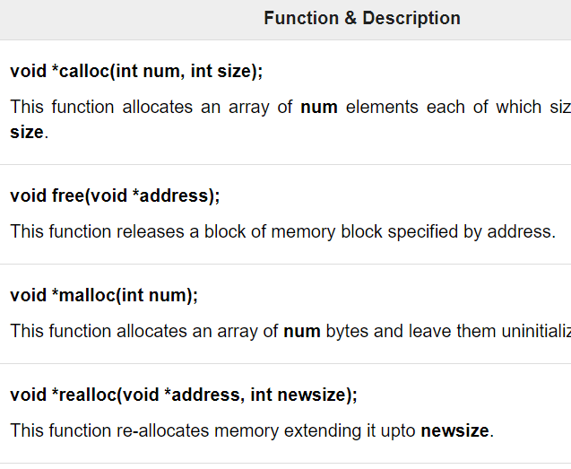
MEMORY MANAGEMENT IN C
The C programming language provides several functions for memory allocation and management. These functions can be found in the <stdlib.h> header file.

Slide 22
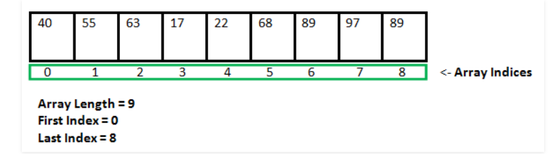
Dynamic Memory Allocation in C.

Slide 23
SCOPE OF VARIABLES
A scope in any programming is a region of the program where a defined variable can have its existence and beyond that variable it cannot be accessed. There are three places where variables can be declared in C programming language −
Inside a function or a block which is called local variables.They can be used only by statements that are inside that function or block of code. Local variables are not known to functions outside their own.
Outside of all functions which is called global variables.Global variables hold their values throughout the lifetime of your program and they can be accessed inside any of the functions defined for the program. A global variable can be accessed by any function.
The definition of function parameters which are called formal parameters.Formal parameters, are treated as local variables with-in a function and they take precedence over global variables.

Slide 24
STORAGE CLASSES
A storage class defines the scope (visibility) and life-time of variables and/or functions within a C Program. They precede the type that they modify. We have four different storage classes in a C program −
Auto:- The auto storage class is the default storage class for all local variables.
{ int month; auto int month; }
The example above defines two variables within the same storage class. 'auto' can only be used within functions, i.e., local variables.
Register:- The register storage class is used to define local variables that should be stored in a register instead of RAM. This means that the variable has a maximum size equal to the register size (usually one word) and can't have the unary '&' operator applied to it (as it does not have a memory location).

Slide 25
The register should only be used for variables that require quick access such as counters. It should also be noted that defining 'register' does not mean that the variable will be stored in a register. It means that it MIGHT be stored in a register depending on hardware and implementation restrictions.
The static Storage Class:-
The static storage class instructs the compiler to keep a local variable in existence during the life-time of the program instead of creating and destroying it each time it comes into and goes out of scope. Therefore, making local variables static allows them to maintain their values between function calls.
The static modifier may also be applied to global variables. When this is done, it causes that variable's scope to be restricted to the file in which it is declared.
In C programming, when static is used on a global variable, it causes only one copy of that member to be shared by all the objects of its class.
The extern Storage Class:-
The extern storage class is used to give a reference of a global variable that is visible to ALL the program files. When you use 'extern', the variable cannot be initialized however, it points the variable name at a storage location that has been previously defined.
When you have multiple files and you define a global variable or function, which will also be used in other files, then extern will be used in another file to provide the reference of defined variable or function. Just for understanding, extern is used to declare a global variable or function in another file.

Slide 26
STRUCTURES & UNIONS
Structures are user defined data types
• It is a collection of heterogeneous data
• It can have integer, float, double or character data in it
• We can also have array of structures
struct <structname>
{ members;
} element;
We can access element.members;
struct Person {
int id;
char name[5];
}P1;
P1.id = 1;
P1.name = “Bhasu”;

Slide 27
Type def •
The typedef operator is used for creating alias of a data type • For example I have this statement typedef int integer; Now I can use integer in place of int i.e instead of declaring int a;, I can use integer a; This is applied for structures too.
Unions are a concept borrowed from structures and therefore follow the same syntax as structures.
 Major diffferance in terms of Storage:
In structures each member has its own storage location
In unions all members use the same location
Union may contain many members of different type but can handle only one member at a time.
 It can be declared using keyword union as follows:
 union item {
int m;
float x;
char c;
} code;
A union variable can be assigned to another union variable.
 Address of the union variable is obtained using the address of ‘&’ operator.
 It is to pass a union to function and a function can return a union.
 We can use pointer to unions and within unions.

Slide 28
RECURSION
Recursion is the process of repeating items in a self-similar way. In programming languages, if a program allows you to call a function inside the same function, then it is called a recursive call of the function.
void recursion() { recursion(); /* function calls itself */ } int main() { recursion(); }
While using recursion, programmers need to be careful to define an exit condition from the function, otherwise it will go into an infinite loop.
Recursive functions are very useful to solve many mathematical problems, such as calculating the factorial of a number, generating Fibonacci series, etc.

Slide 29
C PREPROCESSORS
The C preprocessor executes before a program is compiled.
Some actions it performs are the inclusion of other files in the file being compiled, definition of symbolic constants and macros, conditional compilation of program code and conditional execution of preprocessor directives.
Preprocessor directives begin with # and only white-space characters and comments may appear before a preprocessor directive on a line.
The #include directive causes a copy of a specified file to be included in place of the directive.
The two forms of the #include directive are:
#include <filename> #include "filename"
The difference between these is the location the preprocessor begins searches for the file to be included.
If the file name is enclosed in quotes, the preprocessor starts searches in the same directory as the file being compiled for the file to be included (and may search other locations, too)

Slide 30
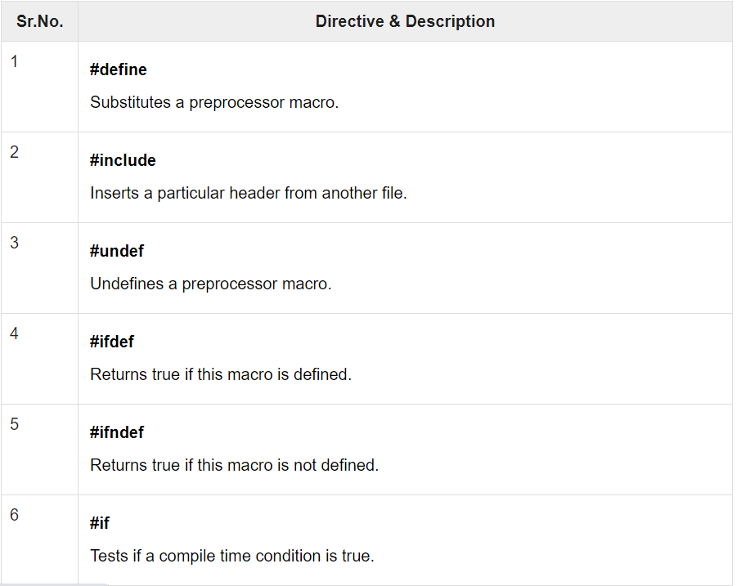
The table below describes some of the preprocessor directives:-

Slide 31
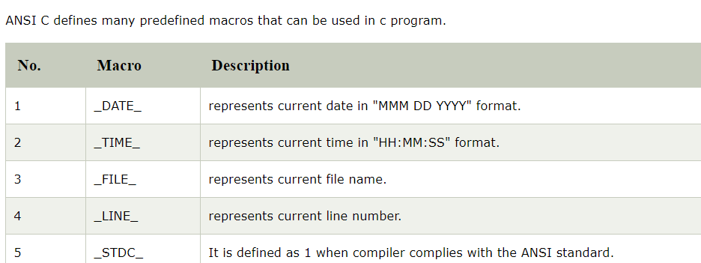
MACROS
A macro is a segment of code which is replaced by the value of macro. Macro is defined by #define directive. There are two types of macros:
Object-like Macros
Function-like Macros
The object-like macro is an identifier that is replaced by value. It is widely used to represent numeric constants. For example:
#define PI 3.14 Here, PI is the macro name which will be replaced by the value 3.14.
The function-like macro looks like function call. For example:
#define MIN(a,b) ((a)<(b)?(a):(b)) Here, MIN is the macro name

Slide 32

DATASTRUCTURES

Slide 33
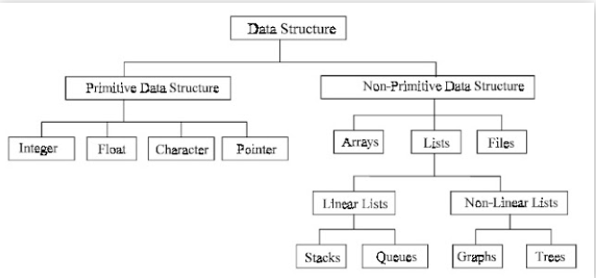
Data structure is representation of the logical relationship existing between individual elements of data.
In other words, a data structure is a way of organizing all data items that considers not only the elements stored but also their relationship to each other.
Data structure are normally divided into two broad categories:
Source: Internet

Slide 34
DIFFERENCE BETWEEN BOTH??
PRIMITIVE DATATYPE
NONPRIMITIVE DAYATYPE
A primitive data structure is generally a basic structure that is usually built into the language, such as an integer, a float.
There are basic structures and directly operated upon by the machine instructions
A non-primitive data structure is built out of primitive data structures linked together in meaningful ways, such as a or a linked-list, binary search tree, AVL Tree, graph etc.
emphasize on structuring of a group of homogeneous (same type) or heterogeneous (different type) data items

Slide 35

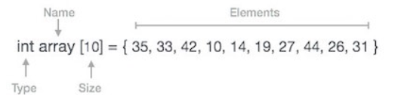
ARRAYS
Arrays are the simplest data structures that stores items of the same data type.
A basic application of Arrays can be storing data in tabular format. For example, if we wish to store the contacts on our phone, then the software will simply place all our contacts in an array.
Arrays can be declared in various ways in different languages. For illustration, let's take C array declaration.

Slide 36
•If an element is referenced by a single subscript, then array is known as 1-D or single array (linear array). --- Array[N] •
If two subscripts are required, the array is known as 2-D or matrix array. ---- Array[M][N] •
An array referenced by two or more subscripts is known as multidimensional array. ----- Array[X][Y][Z]
Sparse array is an application of arrays where nearly all the elements have same values (usually zeros) and this value is constant. 1-D sparse array is called sparse vector and 2-D sparse array is called sparse matrix.
Following are the basic operations supported by an array.
Traverse − print all the array elements one by one.
Insertion − Adds an element at the given index.
Deletion − Deletes an element at the given index.
Search − Searches an element using the given index or by the value.
Update − Updates an element at the given index.

Slide 37
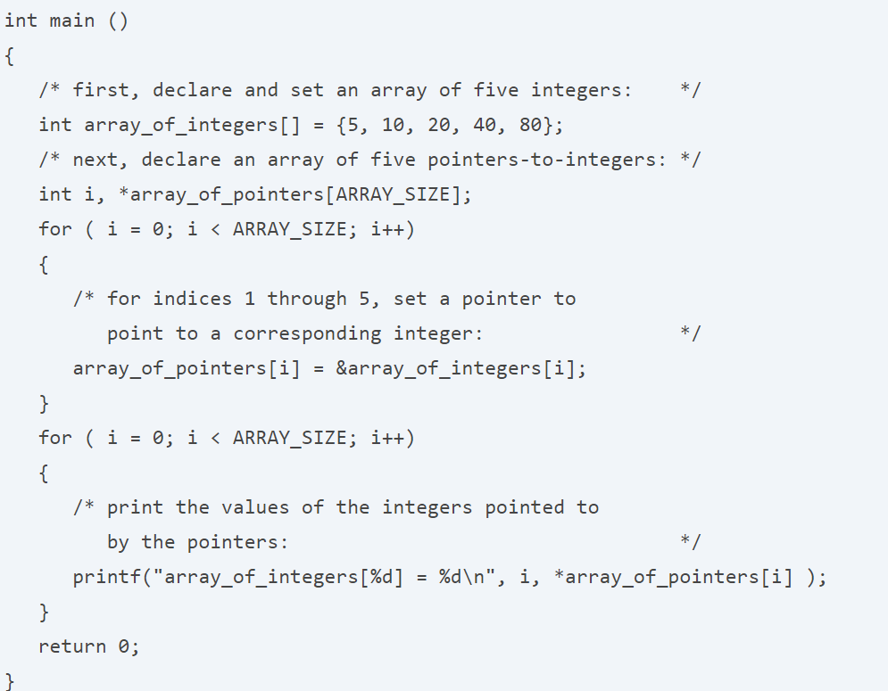
ARRAY OF POINTERS
In computer programming, an array of pointers is an indexed set of variables, where the variables are pointers (referencing a location in memory).
Below is an array of pointers in C that points each pointer in one array to an integer in another array. The value of each integer is printed by dereferencing the pointers. In other words, this code prints the value in memory of where the pointers point.

Slide 38
The result obtained will be:-
array_of_integers[0] = 5 array_of_integers[1] = 10 array_of_integers[2] = 20 array_of_integers[3] = 40 array_of_integers[4] = 80

Slide 39

LINKED LISTS
A linked list is a sequence data structure, which connects elements, called nodes, through links.
Some applications of the linked list are:
Images are linked with each other. So, an image viewer software uses a linked list to view the previous and the next images using the previous and next buttons.
Web pages can be accessed using the previous and the next URL links which are linked using linked list.
To keep the track of turns in a multi player game, a circular linked list is used.

Slide 40
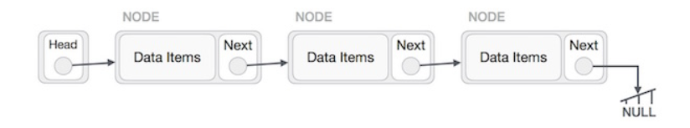
Types of Linked List:-
Following are the various types of linked list.
Simple Linked List − Item navigation is forward only.
Doubly Linked List − Items can be navigated forward and backward.
Circular Linked List − Last item contains link of the first element as next and the first element has a link to the last element as previous.
Basic Operations:-
Following are the basic operations supported by a list.
Insertion − Adds an element at the beginning of the list.
Deletion − Deletes an element at the beginning of the list.
Display − Displays the complete list.
Search − Searches an element using the given key.
Delete − Deletes an element using the given key.

Slide 41
STACKS
A Stack is a list of elements in which an element may be inserted or deleted at one end which is known as TOP of the A Stack is a list of elements in which an element may be inserted or deleted at one end which is known as TOP of the stack.
Push: add an element in stack
Pop: remove an element in stack

Slide 42
ALGORITHM FOR BOTH THE OEPRATIONS.
PUSH OPERATION
begin procedure push: stack, data if stack is full return null endif top ← top + 1 stack[top] ← data end procedure
POP OPERATION
begin procedure pop: stack if stack is empty return null endif data ← stack[top] top ← top - 1 return data end procedure
Some Applications of a stack are:
Converting infix to postfix expressions.
Undo operation is also carried out through stacks.
Syntaxes in languages are parsed using stacks.

Slide 43
QUEUE
A queue is a linear list of element in which insertion can be done at one end which is known as front and deletion can be done at other end which is known as rear.
Insertion : add a new element in queue
Deletion: Removing an element in queue

Slide 44
Types of Queues:-
1. Circular Queue:- Elements are represented in circular fashion. Insertion is done at very first location if last location is full. Rear=(rear + 1) % Size Front=(Front +1) % Size
2. Double Ended Queue (deque):- Elements can be inserted or deleted from both ends. Input restricted deque-insertion at only one end Output restricted deque-deletion at only one end
3. Priority Queue:- Each element is assigned with a priority An element with higher priority is processed first Two elements with same priority are processed in FIFO order.
Queue Operations:
Enqueue()
Dequeue()
Front() Size()
IsEmpty() Queue
Applications:
Direct applications •Waiting lines •
Access to shared resources (e.g., printer)
•Multiprogramming Indirect applications

Slide 45
TREE
In computer science, a tree is a widely-used data structure that emulates a hierarchical tree structure with a set of linked nodes.
OPERATIONS ARE:-
.Insertion 2.Deletion 3.Searching

Slide 46
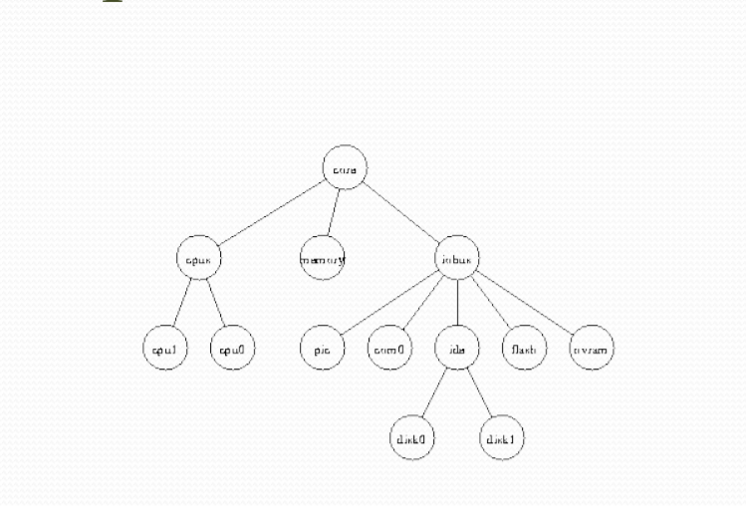
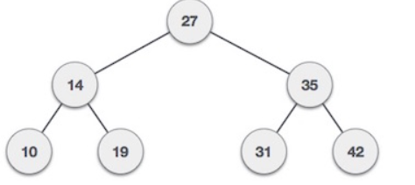
Tree Representation
Binary Search Tree Representation:-
Binary Search tree exhibits a special behavior. A node's left child must have a value less than its parent's value and the node's right child must have a value greater than its parent value.

Slide 47
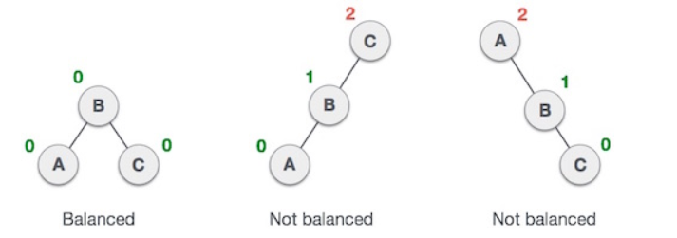
BST Basic Operations
The basic operations that can be performed on a binary search tree data structure, are the following −
Insert − Inserts an element in a tree/create a tree.
Search − Searches an element in a tree.
Preorder Traversal − Traverses a tree in a pre-order manner.
Inorder Traversal − Traverses a tree in an in-order manner.
Postorder Traversal − Traverses a tree in a post-order manner.
AVL TREES
Named after their inventor Adelson, Velski & Landis, AVL trees are height balancing binary search tree. AVL tree checks the height of the left and the right sub-trees and assures that the difference is not more than 1. This difference is called the Balance Factor.
Here we see that the first tree is balanced and the next two trees are not balanced −
Another category of Balanced Binary search tree is the Red Black Tree which is generally used for performing better insertion and deletion operation than AVL trees.

Slide 48
GRAPHS.
A graph data structure may also associate to each edge some edge value, such as a symbolic label or a numeric attribute (cost, capacity, length, etc.).
OPERATIONS PERFORMED:-
1.Searching 2.Insertion 3.Deletion

Slide 49
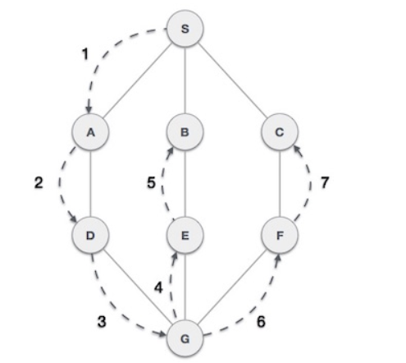
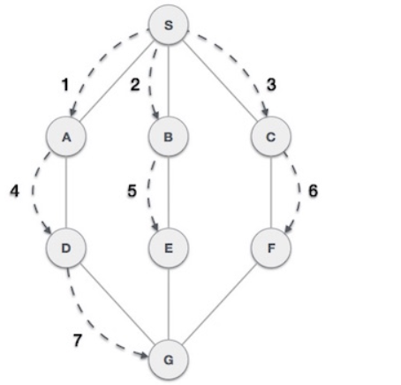
GRAPH TRAVERSAL TECHNIQUES:-
Depth First Search (DFS) algorithm traverses a graph in a depthward motion and uses a stack to remember to get the next vertex to start a search, when a dead end occurs in any iteration.
Breadth First Search (BFS) algorithm traverses a graph in a breadthward motion and uses a queue to remember to get the next vertex to start a search, when a dead end occurs in any iteration.

Slide 50
SEARCHING
Linear search is a very simple search algorithm. In this type search, a sequential search is made over all items one by one. Every items is checked & if a match founds them Particular item is returned otherwise search continues till the end of the data collection.
Binary search is a fast search algorithm with run-time complexity of 0 (log n) . This search algorithm works on the principle of divide & compare. For this algorithm to work properly the data collection should be in sorted form.

Slide 51
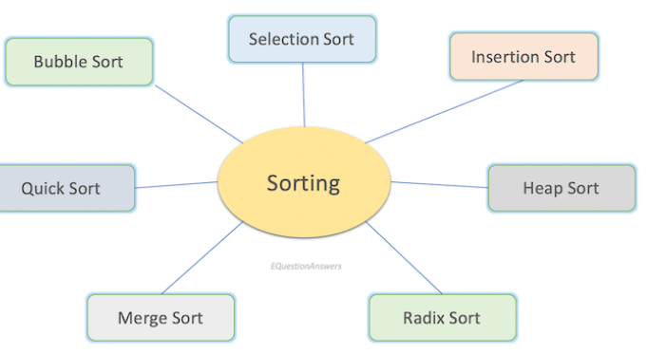
SORTING

Slide 52
There are the several sorting algorithms used in practical fields.
Bubble Sort- A sorting algorithm which compares one element to its next element and if requires it swaps like a bubble.
Selection Sort - A sorting algorithm which selects a position in the elements and compares it to the rest of the positions one by one.
Insertion Sort - A sorting algorithm which selects one element from the array and is compared to the one side of the array. Element is inserted to the proper position while shifting others.
Quick Sort - A sorting algorithm which divides the elements into two subsets and again sorts recursively.
Heap Sort - A sorting algorithm which is a comparison based sorting technique based on Binary Heap data structure.
Merge sort - A sorting algorithm which divides the elements to subgroups and then merges back to make a sorted.
Radix Sort - A sorting algorithm used for numbers. It sorts the elements by rank of the individual digits.

Slide 53

Thank you
- Presented by BHASWATI SENGUPTA

